Slide 1
551-1119-00L Microbial Community Genomics
16S rRNA amplicon data analysis using DADA2

Slide 2
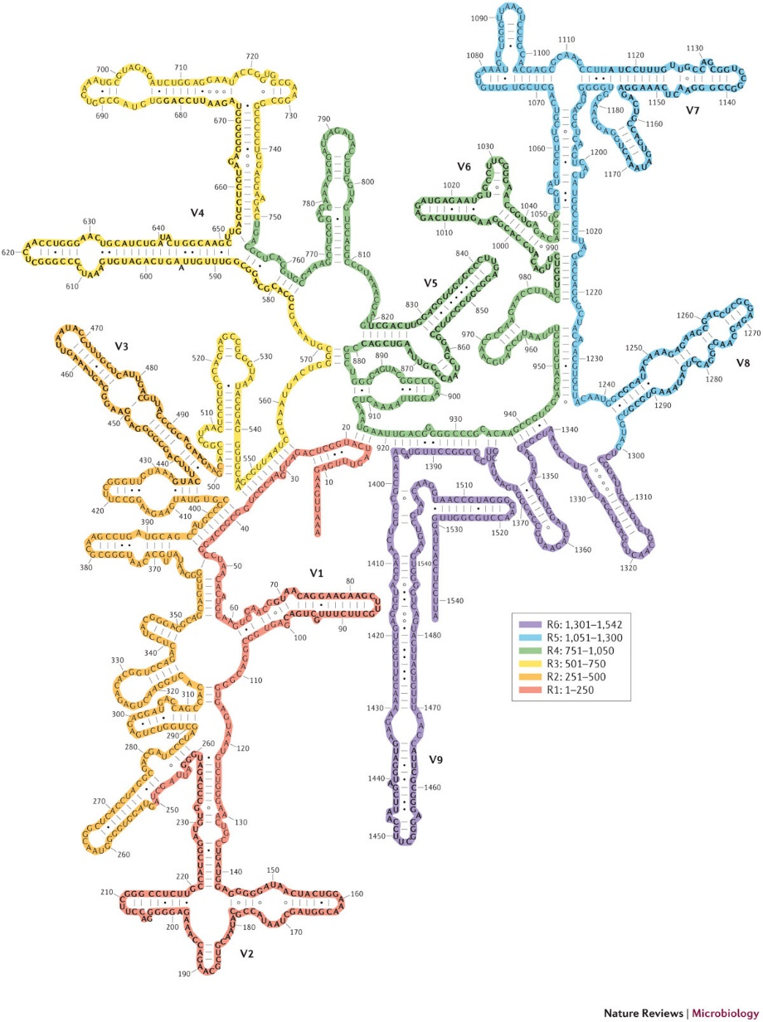
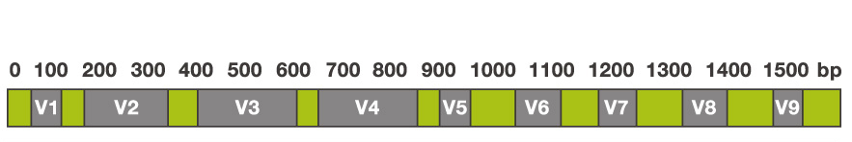
The 16S rRNA gene
Part of prokaryotic ribosomes
16S rRNA present in all prokaryotes
conserved regions and variable regions
Secondary structure of 16S rRNA
50S large subunit (33 proteins) | 5S: 120 nt 23S : 2906 nt
30S small subunit (22 proteins) | 16S: 1542 nt
30S small subunit
blue: ribosomal proteins
gold: 16S rRNA

Slide 3
Generation of 16S rRNA gene PCR amplicons
V4 Region of 16S rRNA gene (ca. 250 nt)
16S rRNA gene
forward primer
CTCGACATTCTA
5’-ACTACGATCACGTACTCGACATTCTAACGCTCTGAGCGGTAAGCACTAAGTCACACTGCTCGCAGTCTGAGTAGCTAG-3’
GAGCGTCA
sequencing
reverse primer
forward reads
CTCGACATTCTAACGCTCTGAGCGGTAAGCTCTAAGTCACA…
reverse reads
ACTGCGAGCAGTGTGACTTAGAGCTTACCGCTCAGAGCGT…
PCR products (amplicons) are used for sequencing
The sequencing output are forward reads and reverse reads
Sequencing reads are saved as plain (or compressed) text files in the fastq format
see: https://en.wikipedia.org/wiki/FASTQ_format

Slide 4

Quality control reads: primer match filtering
primer match
CTCGACATTCTA
primer mismatch
CTCGACATTCTAACGCTCTGAGCGGTAAGCACTAAGTCACACTGGATCGTCG
discard read
GAGCGTCA
primer match
CTCGACATTCTA
primer match
CTCGACATTCTAACGCTCTGAGCGGTAAGCACTAAGTCACACTGGAGCGTCA
GAGCGTCA
ACGCTCTGAGCGGTAAGCACTAAGTCACACTG
16s rRNA V4 region
Forward and reverse primer sequences are aligned to the read.
If both primers perfectly match, the read is used for further steps, otherwise the read is discarded.
This assures that all reads start at the same 16S position, which is mandatory for the pipeline to work.

Slide 5
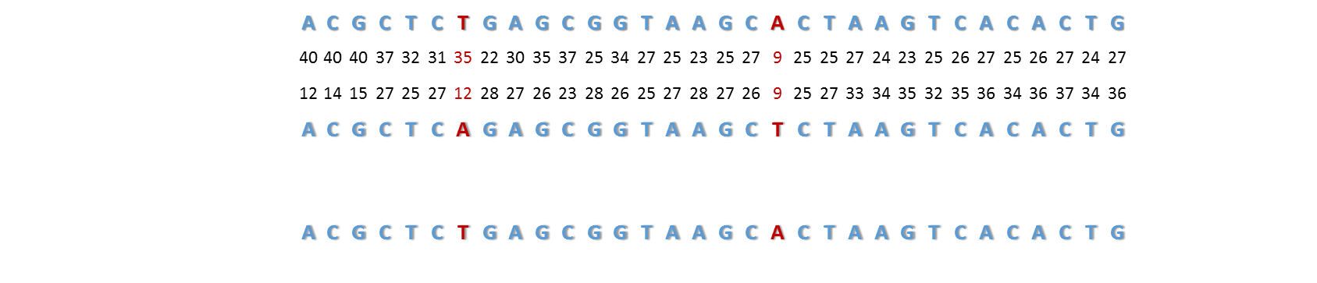

Quality scores of amplicon reads
forward read
CTCGACATTCTA
quality scores relate to
error probability:
$$P=10\frac{−Q}{10}$$
GAGCGTCA
reverse read
Each base of the forward and reverse have a quality (Q) score:
the higher the Q score the higher the probability that the base call is correct

Slide 6

Quality control of amplicon reads: error filtering
Quality filtering by maximum expected errors (maxEE) should be performed as a first processing step
EE = expected errors = sum of error probability (sum of P)
small EE = high quality; large EE = low quality
By setting a maximum expected errors (maxEE) threshold, we can discard reads with EE > maxEE
If EE < maxEE
If EE > maxEE
keep high quality read
discard low quality read
Notes:
Remember: Q score can tell us only an estimated error and not exactly how many errors are in a read.

Slide 7
The Divisive Amplicon Denoising Algorithm (DADA)
The core denoising algorithm in the DADA2 R package is built on a model of the errors in Illumina-sequenced amplicon reads.
This error model quantifies the rate λ_{ji} at which an amplicon read with sequence i is produced from sample sequence j as a function of sequence composition and quality.
Sample sequences
Amplicon reads
Operational taxonomic units
errors
OTU 1
OTU 2
DADA2
OTU clustering

Slide 8
The Divisive Amplicon Denoising Algorithm (DADA)
DADA2 tries to decipher whether each amplicon is a true biological sequence or is the result of an error because of the sequencing process
Sample sequences
Amplicon reads
Operational taxonomic units
errors
OTU 1
OTU 2
DADA2
OTU clustering

Slide 9
DADA2: the error model
The rate at which an amplicon read with sequence i is produced from sample sequence j is reduced to the product over the transition probabilities between the L aligned nucleotides.
The transition probability between aligned nucleotides is allowed to depend on the original nucleotide, substituting nucleotide, and associated quality score, for example, p(A→T, 9)

Slide 10
DADA2: the error model

Slide 11
DADA2: the abundance p-value
The abundance p-value quantifies the notion that sequence i is too abundant to be explained by errors in amplicon sequencing.
It measures the probability of a given amplicon abundance given the model. That is, the likelihood that an amplicon is produced n times because errors.
N_{i}=3
N_{i}=3
N_{j}=20,000
N_{j}=20
High p-value
Low p-value
i is an error
j is a true sequence

Slide 12
Merging and chimera removal
Merging:
Chimera detection and removal:
Chimeric sequences are identified if they can be exactly reconstructed by combining a left-segment and a right-segment from two more abundant “parent” sequences
R1 ASV
R2 ASV
At least 12 nt and perfect match

Slide 13
Taxonomic annotation of ASVs
Taxonomy
Database of taxonomically annotated
16S sequences
Phylum
Class
Order
Family
Genus
Species
Sequence of OTU 1
ACGCTCAGAGCGGTAAGCACTAA
Prediction of ASV taxonomy
Each is compared to a database of annotated 16S rRNA gene sequences
Sequences are classified to a phylum, class, family etc.

